Slide 1



Tuesday 26th May Higher Computing Science Days Peter Donaldson and Quintin Cutts

Slide 2
SDD: Open Data, Files & Records
Open data is an increasing popular phenomenon
schools, home, driving licences, health service
Interesting context for practice:
handling files of data
developing small programs to analyse the data
Useful skills for pupils
manipulating data in other subjects – e.g. science experiments

Slide 3
This resource: Food Standards
A CSV file of outcomes of assessments of food outlets for Glasgow
but data for any local authority can be accessed
Lesson plan for working with this file programmatically
Series of programs in Haggis
Reading the file into an array of records
Analysing the data in various ways

Slide 4
We'll run through it…

Slide 5
What data do you think government has access to, that you'd like to see?

Slide 6
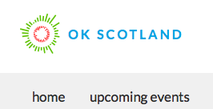
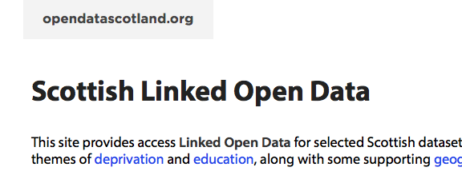
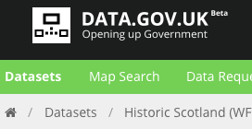

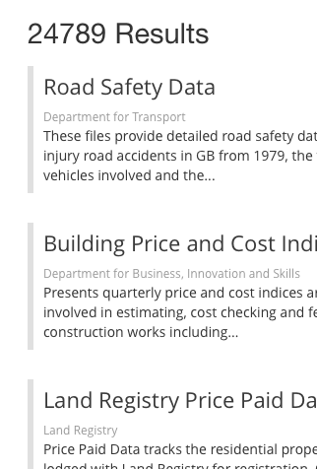
Open Data
Yay! Transparency in government
But what can we do with it?

Slide 7

One example – Food Standards
Reports of food hygience checks in food outlets across each local authority
Let's explore…

Slide 8
The datafile – a short excerpt
What's in it?
What are the major entities?
What questions could you answer using this dataset?
e.g. How many food outlets are there in Glasgow?
think of others

Slide 9
Which data items do we need to solve the following?
How many failed in my postcode, within a radius of my current position, in the last n days?
What are their names?
List all the types of food outlet.
Count of restaurants near here.
Which post-code area (e.g. G12, G4) has the highest percentage of failed outlets at this time?
Business name, business type, postcode, rating date, rating result, location

Slide 10
Reading the data in…
Explore Handout 2 with your partner(s)
Make sure you can find and understand the following:
The record type declaration
Where the file is opened and how lines are read in
How the data is extracted from each line and placed in a record
How the whole data set is stored

Slide 11
Develop a plan!
To find out the following information
get the name of all failed outlets within a 1 mile radius of a given position (e.g. my current position)
Review Handout 3
How does it compare with your plan?
Annotate each line of the program
the construct being used with a brief explanation
how the line contributes to solving the problem

Slide 12
Now write code to…
Count up how many outlets passed in the G12 postcode area
Solution is in Handout 4 – compare it with your solution
And a larger task:
Which post-code area (e.g. G12, G4) has the highest percentage of failed outlets?

Slide 13
Plan for this problem
Define a record (post-code area, number of failed outlets, total number of outlets)
Set up a data array of this record type
Traverse over the records in the main data structure in turn:
the data array must be checked to see if the record's post-code area has been seen before
If it's a new post-code area, a new entry must be created in the data array, otherwise the existing entry can be updated.
Finally, the data array must be traversed, calculating the percentage of failed outlets in each post-code area, and keeping a link to the entry in the data array with the largest percentage.

Slide 14
If you only wanted to…
Find the number of failed outlets in the whole local authority
… how could your program be simpler?

Slide 15
Summary
Ever more open data available
Similar also to scientific data collected in experiments
Or via apps in your phone that collect data as you go about your daily life
Valuable skillset to be able to analyse this kind of data

